Slide 1
1/21/2023
SUPERVISED LEARNING LINEAR MODELS

Slide 2
1/21/2023
BUILDING SUPERVISED ML ALGORITHMS
Linear models make a prediction using a linear function of the input features.
For regression, the general prediction formula for a linear model is:
ŷ = w[0] * x[0] + w[1] * x[1] + ... + w[p] * x[p] + b
Where: x[0] to x[p] denotes the features
w and b are parameters of the model that are learned
ŷ is the prediction the model makes.
For a dataset with a single feature, the formula is: ŷ = w[0] * x[0] + b which is the equation for a line with a gradient (slope) w[0] and y-axis intercept at b. In the equation with more features these represent the gradient of each feature.
To solve this for the wave dataset we need to draw the line of best fit and calculate W
(∆Y-∆X) and find the b ( Y intercept)
LINEAR MODELS (LM)

Slide 3
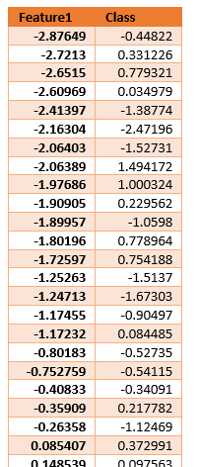
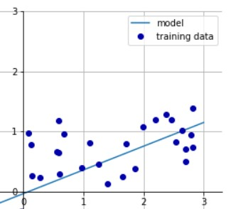
1/21/2023
Just like KNN, Linear Models can be used for building both classification and regression models.
The most common Linear models are regression models hence we start the
discussion with them
Recall the wave dataset. When we visualized it we observe that an increase in feature value leads to an increase in the class value
We can find the gradient W (∆Y/∆X) and y intercept (b) in the function ŷ = w[0] *
x[0] + b by drawing the line of best fit
Manually looking at w[0] we see that the slope should be around 0.4, which we can confirm visually in the plot.The intercept b is where the prediction line should cross the y-axis: this is slightly below zero (-0.03) , which you can also confirm in the image.While this can be done easily for 2 features, for more features, this is challenging
Linear models solve regression problems automatically and the objective is learning the parameters w[0] and b from the data.
NB: Although KNN regressors capture more details because they do not use a straight line, for datasets with many features they do not work well hence linear models are a better choice.
LM FOR REGRESSION ANALYSIS

Slide 4
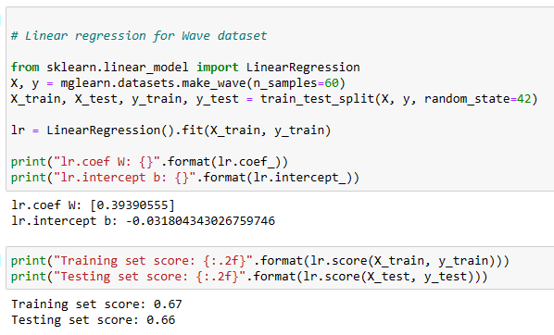
1/21/2023
There are different linear models for regression. The difference between these models lies in how the model parameters w and b are learned from the training data, and how model complexity can be controlled.
The simplest model is the one that uses ordinary least squares (OLS), to finds the parameters w and b that minimize the mean squared error between predictions and the true regression targets, y, on the training set. The mean squared error is the sum of the squared differences between the predictions and the true values. Therefore this model is sometimes known as ordinary least squares
When we create a model , the intercept_ attribute and coef_ are similar to what we obtained manually, for w. and b
NB:
However an accuracy (R² value) of around 0.66 is not very good since the scores on the training and test sets are very close together (i.e. underfitting challenge). Generally, linear models perform better with higher-dimensional datasets.
Linear regression has no parameters, which makes it simple but this also means
that it also has no way to control model complexity.
.
LINEAR REGRESSION MODELS

Slide 5
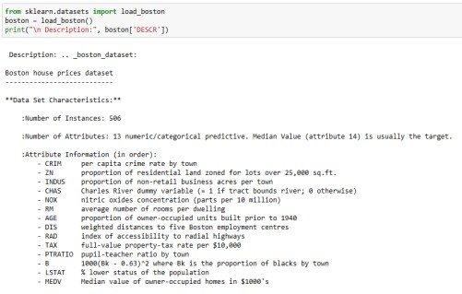
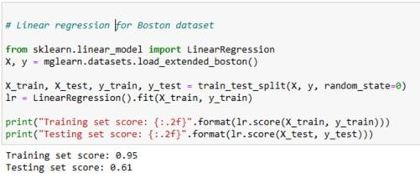
1/21/2023
The Boston Housing dataset is a dataset that is used to predict the value of homes in several Boston neighborhoods in the 1970s, using features such as crime rate, proximity to the Charles River, highway accessibility, and so on. The dataset contains 506 data points, described by 13 features. Because the value of homes is continuous it is a regression problem.
13 features are still relatively small for this algorithm so let us add features in the dataset by adding the interaction between features. For example we know that the features crime rate and highway accessibility can influence each other, hence we create a feature that shows their interaction which is the product of the two. Adding derived feature is called feature engineering and can be done for many reasons as we shall see later, however in this case we do it to improve the performance of our algorithm. We end up with 104 features (the 13 original features together with the 91 possible combinations of two features within those 13 (or you can also choose to combine more than two features)
This inbuilt scikit-learn Boston dataset is modified using mglearn functions and loaded as shown. NB: when working with your own dataset you need to write your own functions for preprocessing
Linear Regression Models work better with more features which reduces the risk of underfitting but exposes it to overfitting.
Although the training scores are high, the model performs poorly on the test set, a clear sign of overfitting.We have limited control over this because they do not have parameters that we can adjust. One of the most commonly used alternatives to standard linear regression is ridge regression.
BOSTON DATASET

Slide 6
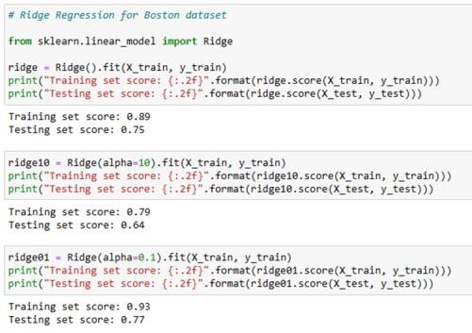
1/21/2023
The formula it uses to make predictions is the same one used for ordinary least squares (OLS). However in ridge regression, the coefficients (w) have an additional goal other than accurate predictions. We want each feature to have little effect on the outcome (∆Y≈0) hence gradient (w) should be as small as possible. This constraint is an example of what is called regularization and is useful in restricting a model to avoid overfitting.
The particular kind used by ridge regression is known as L2 regularization and gives us a parameter that we can control.
Generally, the Training and Test scores converge more for Ridge Regression compared to Linear Regression hence reducing overfitting. It is better to have lower training accuracy and better test accuracy for generalization.
The restriction in Ridge reduce the likelihood of overfitting. The alpha parameter allows a user to control the gradient hence increase the training set performance, albeit at the cost of generalization (depending on what is a priority).
NB:There is no ideal trade-off, the optimum setting of alpha depends on the particular dataset we are using.
Although Ridge has better test results, by increasing the data points, linear regression can also yield better test results. Thus with enough training data, regularization becomes less important because ridge and linear regression will have the same performance.
RIDGE REGRESSION

Slide 7
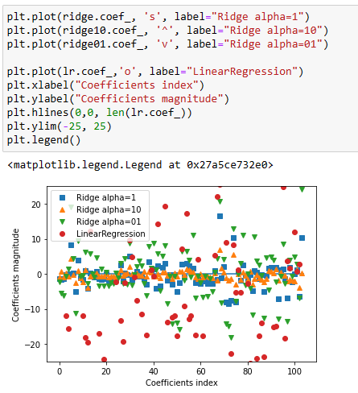
1/21/2023
To analyze how regularization impacts magnitude of coefficients for the different algorithms (Linear regression, and Ridge) we can plot them. Here, the x-axis enumerates the different features.The y-axis shows the magnitude of the coefficients, coef_.
For a large alpha, ( alpha=10) the coefficients have small magnitudes (most have zero) while small ones have very large magnitudes.The best is option is the one that approaches zero without reverting to zero for most, hence alpha=0.1. Linear regression which has no regularization has magnitudes so large they are outside of the chart.
NB: the magnitude of the coefficients never becomes zero with L1 regularization (Euclidean Distance Approach). Hence all features contribute to the prediction
RIDGE REGULARIZATION IMPACT

Slide 8
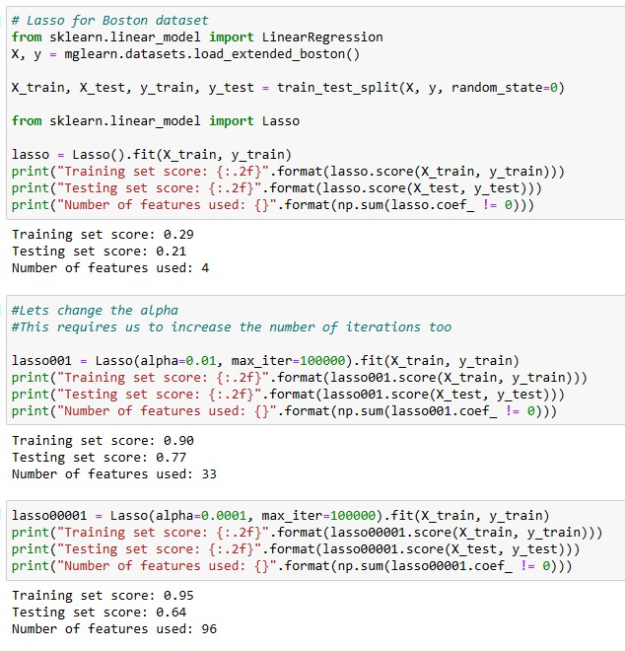
1/21/2023
Like Ridge it restricts coefficients to be close to zero, but in a slightly different way, called L1 regularization. L1 Regularization penalizes the sum of the absolute values of the coefficients (Manhattan Distance).
In this approach some coefficients can become zero hence their features are entirely ignored by the model. In this way it behaves as a form of automatic feature selection. It can reveal the most important features of your model.
Applying it to the to the extended Boston Housing dataset we make the following observations:
The training and test sets are poor before regularization → underfitting, It
used only 4 of the 105 features with the default alpha=1.0.
To reduce underfitting, we introduce a small alpha (the maximum number of iterations have to be increased when you do this, otherwise the lines will fail to converge because the training stopped to early). When we do this more features are selected hence increasing performance.
However if we set alpha too low, we remove the effect of regularization
(behaviour similar to LinearRegression) and end up overfitting,
LASSO REGRESSION

Slide 9
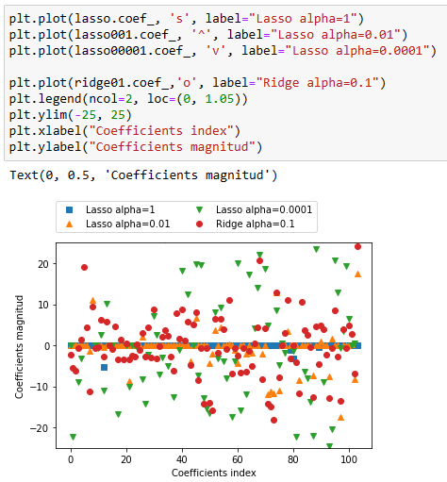
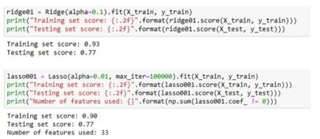
1/21/2023
For alpha=1, most of the coefficients are zero (not ideal).
Decreasing alpha to 0.01, increases the magnitude hence offers the best option of the three.
For comparison, the best Ridge solution is included. We note that for the best Ridge model (alpha=0.1) the coefficient magnitudes are large (non zero) unlike for the best lasso model (alpha=0.01) hence the lasso is suitable for feature selection. Recall the accuracy levels for the two were similar hence only feature importance would lead you to select the later.
LASSO REGULARIZATION IMPACT

Slide 10
1/21/2023
Download the following dataset about concrete from the UCI machine learning repository. Concrete is the most important material in civil engineering. Its compressive strength is a highly nonlinear function of age and ingredients.These ingredients include cement, blast furnace slag, fly ash, water, superplasticizer, coarse aggregate, and fine aggregate. Use it to predict Concretes compressive strength in megapascals.
(https://archive-beta.ics.uci.edu/dataset/165/concrete+compressive+strength )
Use:
Linear Model for Regression
Ridge Regression
Lasso Regression
REGRESSION EXERCISE
CONCRETES COMPRESSIVE STRENGTH
REGRESSION EXERCISE CONCRETES COMPRESSIVE STRENGTH

Slide 11
1/21/2023
Linear models are also used for classification. Predications are made using the following formula:
ŷ = w[0] * x[0] + w[1] * x[1] + ... + w[p] * x[p] + b > 0
While it appears similar to the linear regression function, but we threshold the predicted value at zero. Anything above 0 is predicted as a positive class (+1) while any value below 0 is predicted as a negative class (-1). In this way it acts a binary classification.
The end result is prediction using two classes called linear binary classification
LM FOR CLASSIFICATION
LM FOR CLASSIFICATION

Slide 12
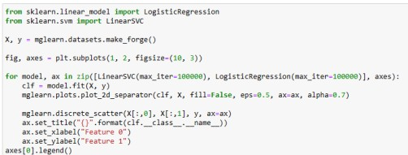
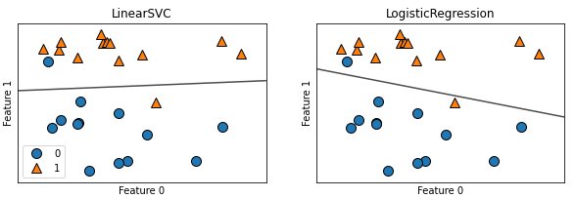
1/21/2023
There are many algorithms for linear binary classification models distinguished how they measure how well coefficients fit training data and the kind of regularization used.
The former calls for adjusting w and b to minimize the number of misclassifications (loss function) which the user often has no control over hence we focus more on the later.
The two most common linear binary classification algorithms are:
logistic regression, - despite the name it’s a classification algorithm
linear support vector Classification
Applying these to our forge dataset and including decision boundaries for ease of analysis we observe that the two models have similar decision boundaries (both misclassify two data points).
LINEAR BINARY CLASSIFICATION (LBC)

Slide 13
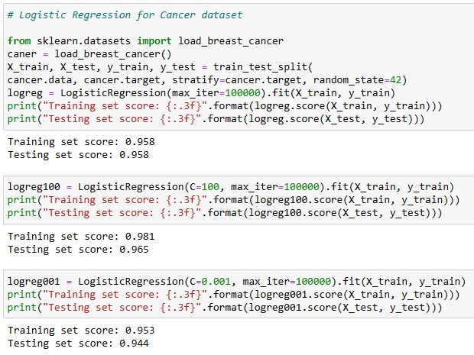
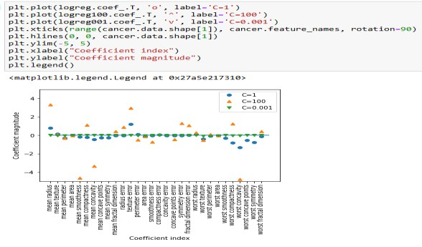
1/21/2023
LBC REGULARIZATION IMPACT
The trade-off parameter that determines the strength of the regularization is called C, and controls (i) the size of the coefficients w, b (low c reduces the magnitude) as well as (ii) the accuracy of training sets (high c tries to fit the training set as best as possible).
Just like linear regression models, linear classification models perform better with higher dimension data by avoiding overfitting. Therefore we shall use the breast cancer dataset and one of the algorithms (logistic regression) to show how controlling the C value impacts regularization
The default value of C=1 provides quite good performance, with 95% accuracy on both the training and the test set. But as training and test set performance are very close, it is likely that we have a simple model (its using few features – thus results are the same). As we increase C ( =100 ) the accuracy starts to differ.
Reducing the c value ( C=0.001) on the other hand decreases both training and test set accuracy (possibly underfitting).
Plotting the coefficient magnitudes for the different models reveals that the default C=1 gives the best model coefficients. Stronger regularization ( C=0.001) pushes coefficients more and more toward zero

Slide 14
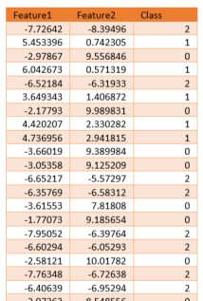
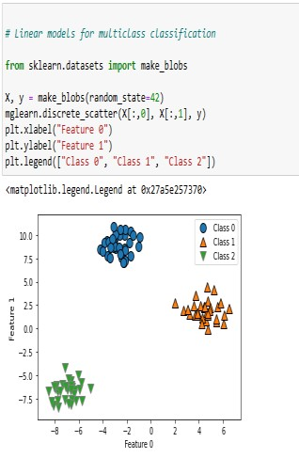
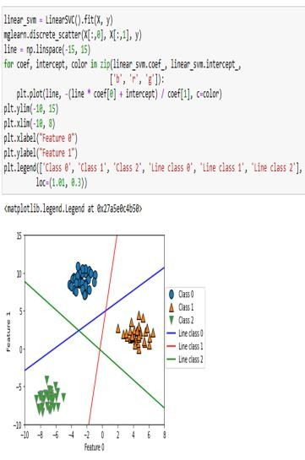
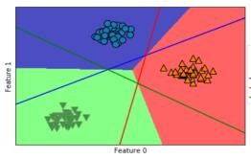
1/21/2023
These are extended from linear binary classification.
A common technique is the one-vs.-rest approach. Here, a binary model is built for each class resulting in as many binary models as there are classes.
To make a prediction, all binary classifiers are run on a class label and the classifier that has the highest score is returned as the prediction. Having one binary classifier per class results in having one vector of coefficients (w) and one intercept (b) for each class.
Let’s apply the one-vs.-rest method to a simple three-class classification dataset. We create another fake small dataset with two features but 3 class labels
When we build the model and visualize the separators for each class we notice that while predictions for some locations are obvious, some are not due to (overlaps). In such locations the class of the closest line is used.The term one vs rest signifies the positive class versus the rest.
LINEAR MULTICLASS CLASSIFICATION MODELS

Slide 15
1/21/2023
Download the following dataset (from Kaggle) with 110.527 medical appointments and 14 associated variables (characteristics). Use it to create a model that can predict whether a patient will show up for the appointment booked or not.
(www.kaggle.com/joniarroba/noshowappointments)
Use:
Linear LogisticRegression
Linear SVC
CLASSIFICATION EXERCISE PATIENT APPOINTMENT

